Slide 1
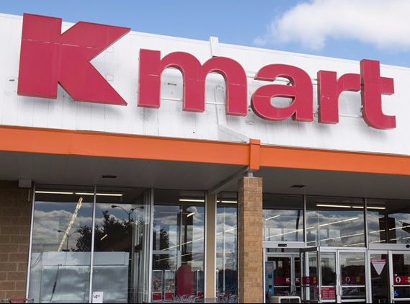
EDA of KMART
Sales startegy for 2020

Slide 2
Agenda
Task is to generate key insights from month wise sales data for 2019, which will help the sales team of Kmart to take some key business decisions towards finetuning their sales strategy.

Slide 3
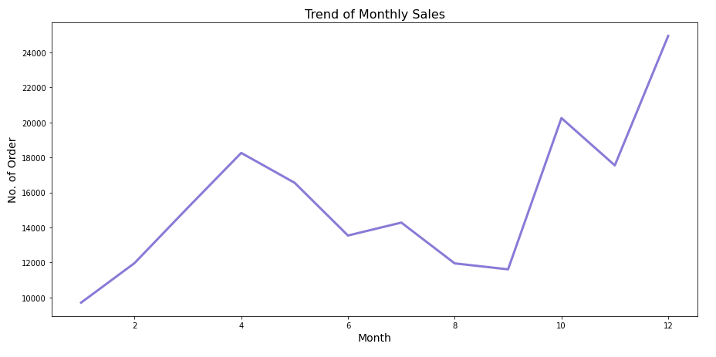
Monthly Ordering Trend
Maximum sales in December, October , April and November during holiday season

Slide 4

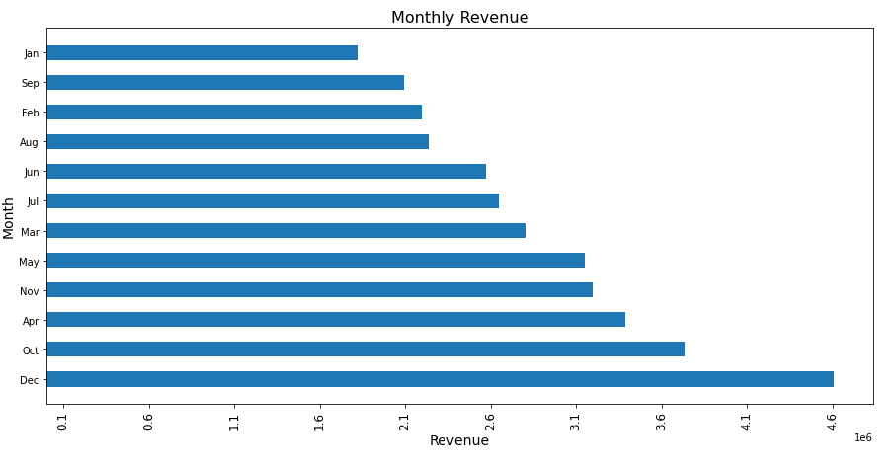
Monthly Revenues (in million dollars)
Holiday seasons witnesses maximum sales, generating maximum revenue
Dec= $4,608,296
Oct= $3,734,778
Apr= $3,389,218
Nov= $3,197,875

Slide 5
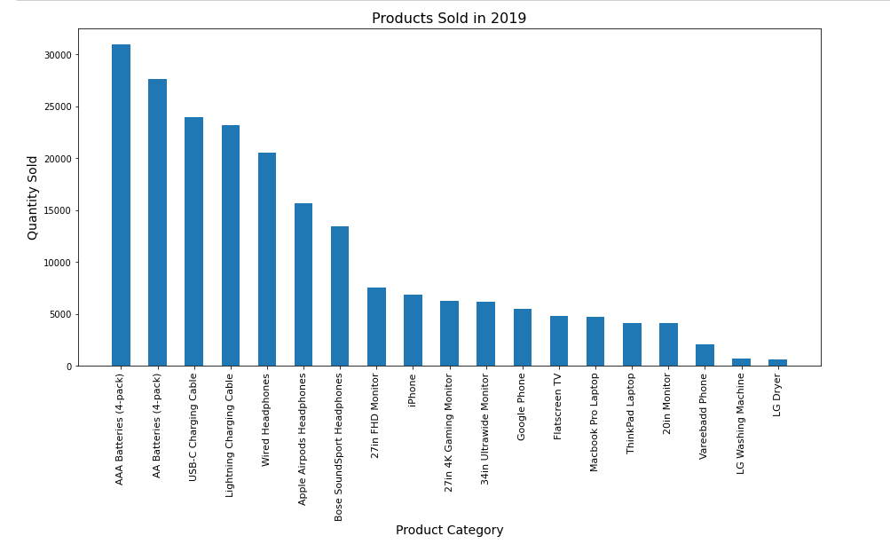
Highest selling product
Top 5 Most sold items are AAA Batteries (4-pack), AA Batteries (4-pack), USB-C Charging Cable and Lightning Charging Cable
Standardization of port designs to USB-C and efficiency of this design, leading to Modern Appliances, Smartphones and gadgets using this design, resulting in the sales of the USB-C Charging Cable.
Apple ecosystem resulting in sales of Lightning Charging Cable

Slide 6

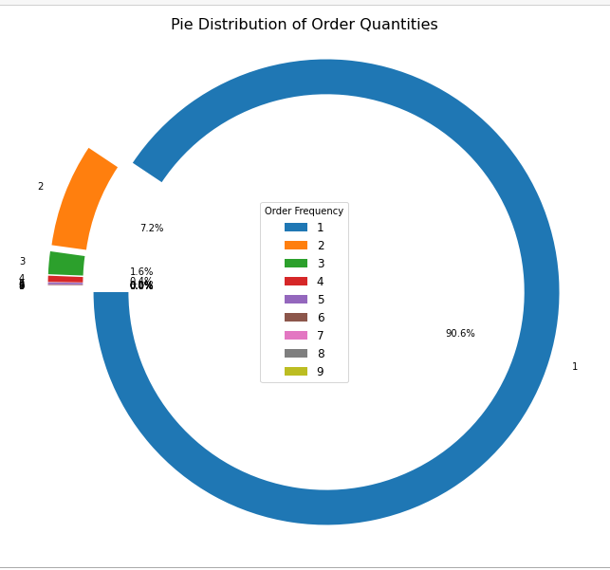
Average Ordered Quantity
90.6% Orders placed for 1unit quantity and 7.2% orders are placed for 2 units quantity

Slide 7
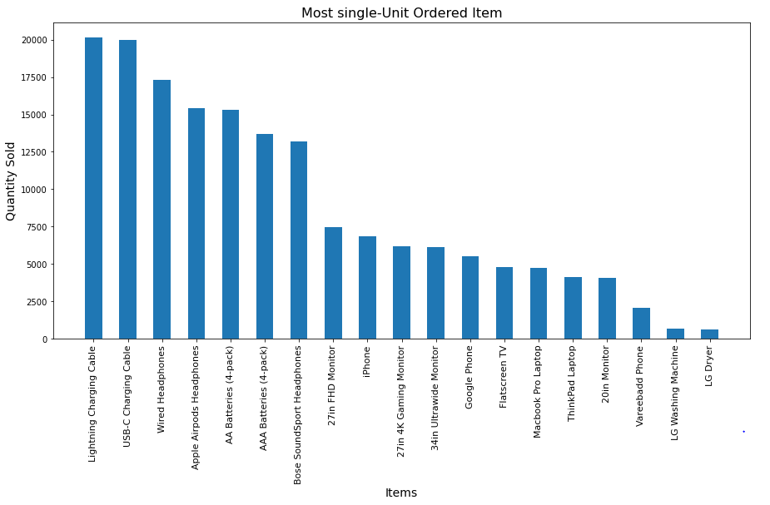
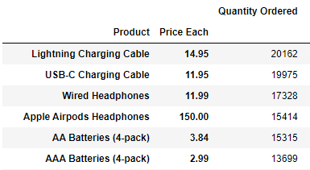
Most Single-unit Sold Product

Slide 8
Average Revenue per Order (in dollars)
Statistics | Revenue
count | 178437.0000
mean | 182.6899
std | 328.4983
min | 2.9900
25% | 11.9500
50% | 14.9500
75% | 150.0000
max | 3400.0000
Average revenue per Order is $182.69
50% orders placed are worth $14.95
50% orders comprises of small orders for low-priced items

Slide 9
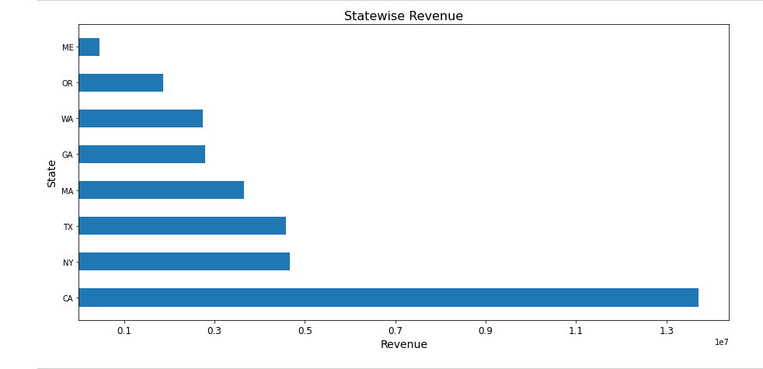
Revenue generated in each State and Cites (in million dollars)
State | City | Revenue
CA | San Francisco | 8,254,744.00
CA | Los Angeles | 5,448,304.00
NY | New York City | 4,661,867.00
MA | Boston | 3,658,628.00
GA | Atlanta | 2,794,199.00
TX | Dallas | 2,765,374.00
WA | Seattle | 2,745,046.00
OR | Portland | 1,870,011.00
TX | Austin | 1,818,044.00
ME | Portland | 449,321.40

Slide 10
ACTIONABLE INSIGHTS
Marketing and Promotional activities should be focused on the Holiday season
Marketing strategies should be focused mostly on California, New York and Texas
Discounted offers and/or bundled products can be offered to customer for on batteries, chargers and headphones
Sales of AAA batteries(4pack) and chargers indicates increased usage of home automation system and apple ecosystem. From this, we can uncover related electronic items that can lead to similar sales
More analysis is required on the Customers buying only Lightning Charging Cable, USB-C Charging Cable, Wired Headphones and/or Apple Airpods Headphones to uncover their buying habits
As 50% orders are placed for small orders, offers can be focused on low-priced items for profit maximization in volume

